Slide 1


Student Details
Name : Mantrapudi rahul
EMAILID : mantrapudirahul@gmail.com
COLLEGE NAME : giet engineering college
COLLEGE STATE : Andhra pradesh
INTERNSHIP DOMAIN : artificial intelligence & machine learning(aiml)
INTERNSHIP START & :03-06-2024 to 15-07-2024
END DATE

Slide 2
PROJECT TITLE: employee burnout prediction
Project Statement: Predicting Employee Burnout using Linear Regression
This project aims to develop a machine learning model to predict employee burnout based on various workplace factors. By analyzing data on workload, work-life balance, job satisfaction, and other relevant features, the model can identify employees at risk of burnout. This information can be used by organizations to implement proactive measures to prevent burnout and support employee well-being.
The project will focus on building a linear regression model to predict employee burnout scores. The model will be trained and evaluated on a dataset containing employee information and burnout ratings. The evaluation will assess the model's accuracy, precision, and ability to explain the variance in burnout scores.

Slide 3
AGENDA : employee burnout prediction
1. Importing Necessary Libraries
Imported essential libraries for data manipulation, visualization, and machine learning.
2. Loading Dataset
Loaded the dataset from an Excel file.
3. Data Overview
Generated descriptive statistics to understand the dataset's basic properties.
Checked for unique values and data types in each column.
Identified and quantified missing values.
4. Exploratory Data Analysis (EDA)
Analyzed the correlation between numerical features and the target variable ("Burn Rate").
Visualized the distribution of data using pair plots.
Dropped rows with missing values in critical columns.

Slide 4
AGENDA : employee burnout prediction
5.Data Preprocessing
Dropped non-informative columns (e.g., "Employee ID").
Created a new feature representing employee seniority based on the "Date of Joining".
Analyzed and dropped columns with low correlation to the target variable.
6. Encoding Categorical Variables
Visualized the distribution of categorical variables.
Applied one-hot encoding to categorical variables to prepare them for machine learning.
7. Data Splitting and Scaling
Split the data into training and testing sets.
Standardized the feature values using StandardScaler.

Slide 5
AGENDA : employee burnout prediction
8. Saving the Scaler:
Saved the scaler object using pickle for future use.
9. Model Building:
Built and trained a linear regression model using the training data.
10. Model Evaluation:
Evaluated the model's performance using metrics such as Mean Squared Error (MSE), Root Mean Squared Error (RMSE), Mean Absolute Error (MAE), and R-squared (R2) score.
Concluded that the linear regression model performed well based on these metrics, indicating good accuracy and precision in predictions.

Slide 6
PROJECT OVERVIEW
Predictive Modeling
Objective: Develop and train machine learning models to predict the burnout rate for each employee.
Data Insights
Objective: Analyze the data to uncover key factors contributing to employee burnout.
Actionable Recommendations
Objective: Provide insights and recommendations for organizations to effectively mitigate employee burnout.
Project Steps :
Data Understanding and Exploration.
Data Preprocessing.
Model Development.
Model Evaluation and Insights.
Model Evaluation and Insights

Slide 7
WHO ARE THE END USERS of this project?
Employees
Human Resources (HR) Department
Company Executives and Management
Data Scientists and Analysts
Organizational Psychologists
Software Developers
Consultants

Slide 8
YOUR SOLUTION AND ITS VALUE PROPOSITION
The method entails creating a thorough predictive model to evaluate employee burnout depending on a number of variables, including job characteristics, mental health indicators, and demographics. This model will use cutting-edge machine learning techniques to analyze the dataset and identify important predictors of burnout. The following elements are part of the solution:
Proactive Burnout Management:
Seek out and resolve possible burnout problems before they worsen.
Improved Well-Being of Employees:
Encourage a more wholesome and encouraging work atmosphere.
Benefits for the Organization:
Improve the culture and performance of the organization.
Data-Driven Decision Making:
Make strategic decisions based on data insights.

Slide 9
How did you customize the project and make it your own
Comprehensive Knowledge of Context
Advanced Methods for Processing Data
Choosing and Customizing a Model
Including Psychological Aspects
Framework for Continuous Improvement

Slide 10
MODELLING
Getting Ready for Data
Data splitting: Separate the training and testing sets from the dataset.
Feature Scaling: Bringing numerical attributes into uniformity.
Convert categorical variables into a numerical format by encoding them.
Models of Training
Linear Regression Model: Utilizing the training dataset, train the linear regression model.
Evaluation of the Model
Performance Metrics: To evaluate the model's performance, use metrics such as RMSE, MAE, and R2 score.
Model Modification
Feature Selection: To improve model performance, assess and choose the most crucial features.

Slide 11
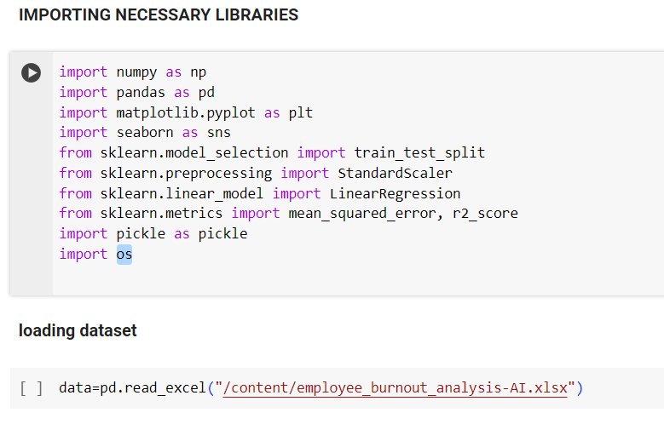
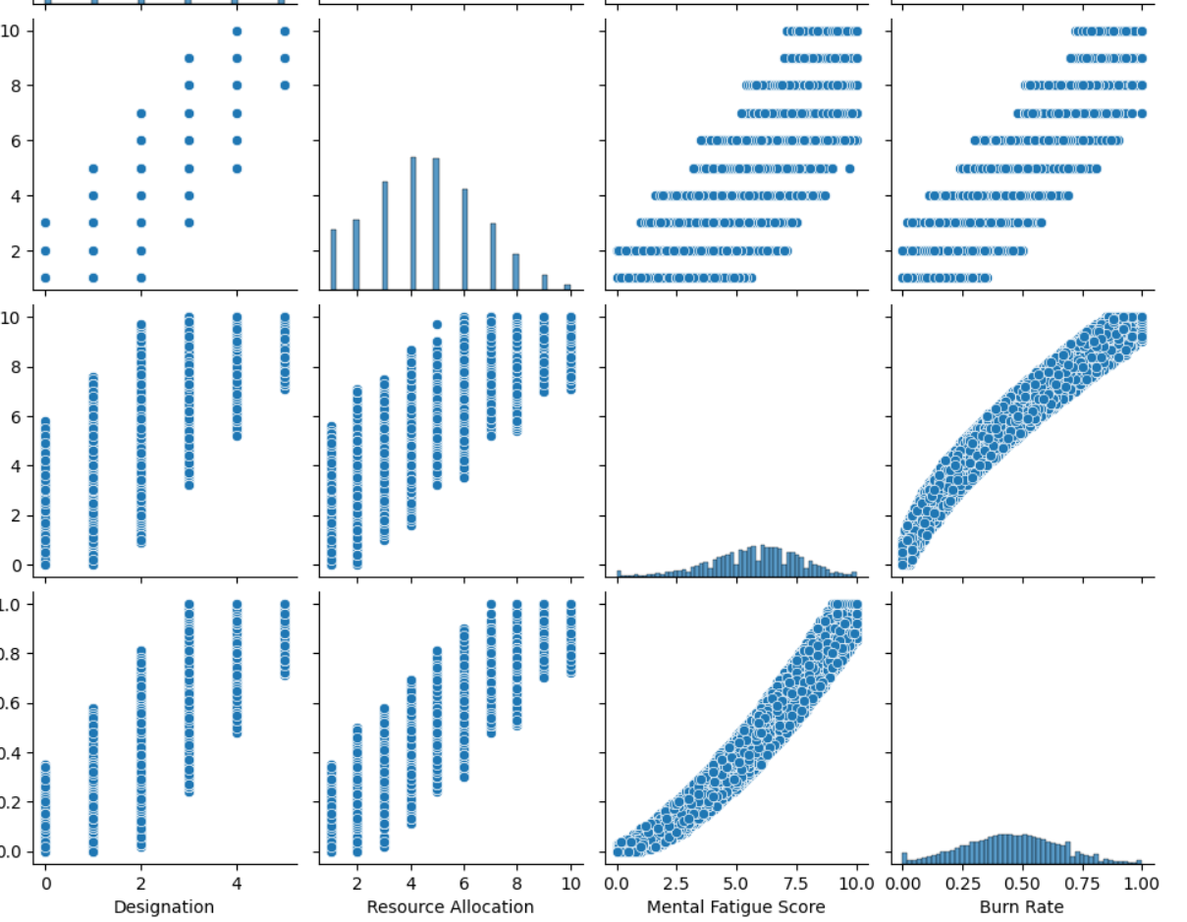
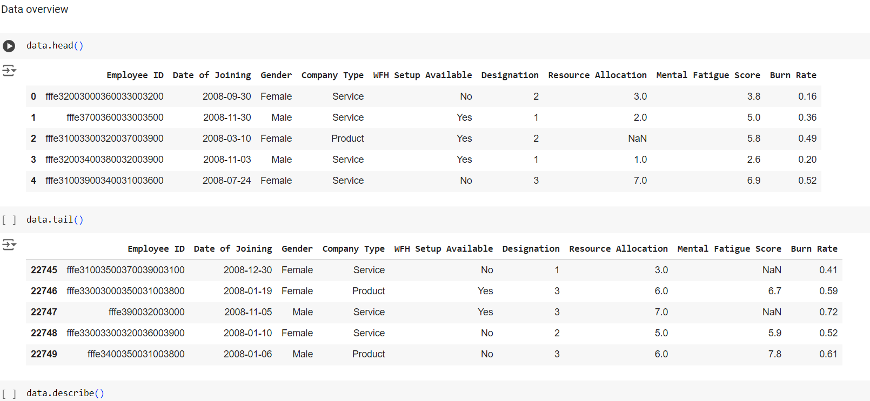
Results

Slide 12
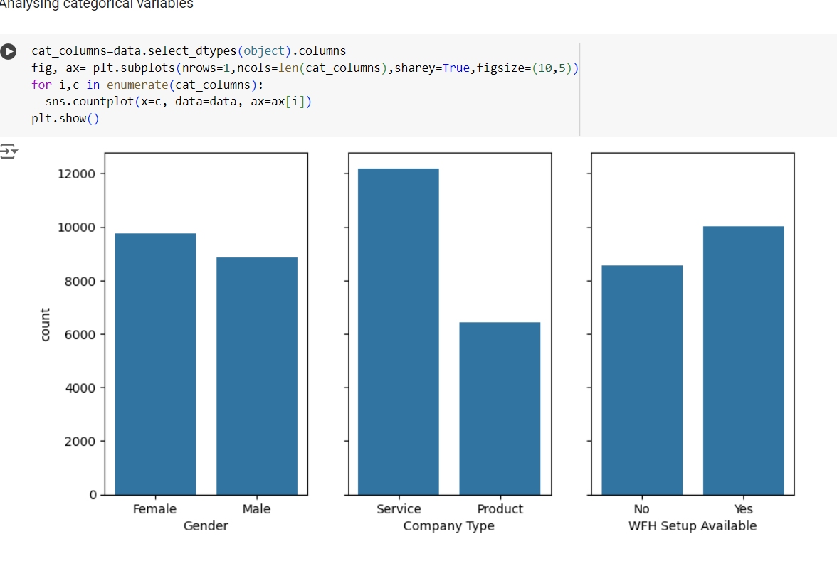
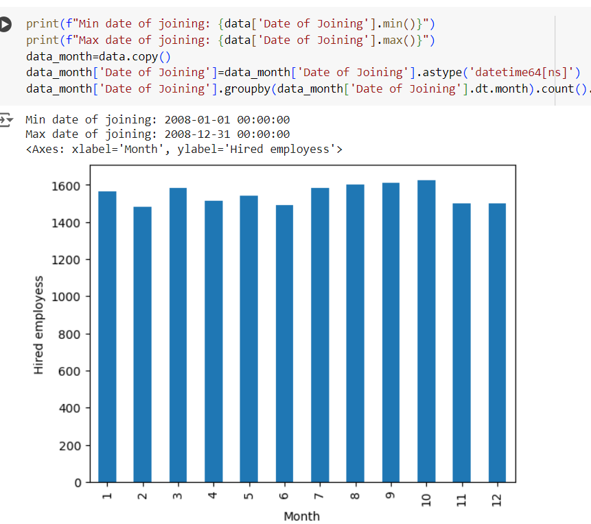
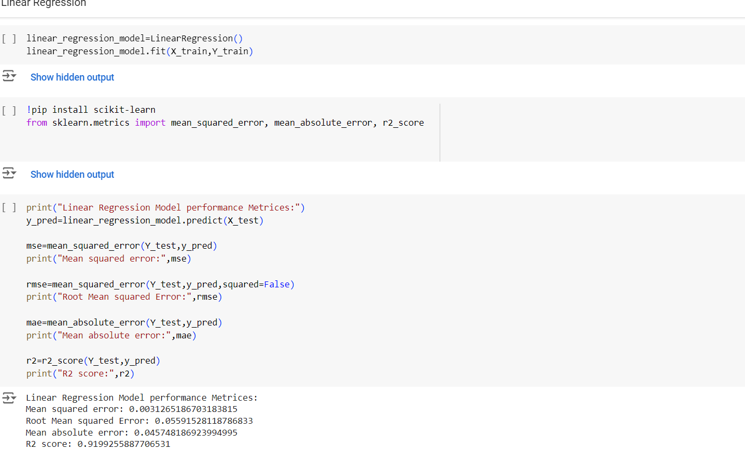

Slide 13
links
GITHUB LINK : https://github.com/MantrapudiRahul/Employe-Burnout-prediction.git
DATASET : https://docs.google.com/spreadsheets/d/14AEJOoRPdwsux2WlOfxRAkyQ9pCeLY4w/edit?usp=drivesdk&ouid=104454510462773132905&rtpof=true&sd=true
MAIL : mantrapudirahul@gmail.com

